Slide 1
Digital Logic Design
Chapter 6
Sequential Logic

Slide 2
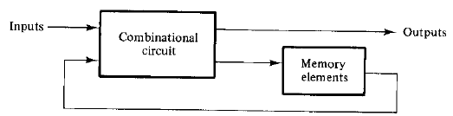
Introduction
In combinational circuit, the outputs at any instant time are entirely dependent upon the inputs present at that time.
Most systems encountered in practice also include memory elements can be described in terms of sequential logic.

Slide 3
Introduction
There are two main types of sequential circuits:
Synchronous sequential circuit: it employs signals that affect the memory elements only at discrete instants of time.
Asynchronous sequential circuit: it depends upon the order on which its input signals change and can be affected at any instant of time.
Synchronous sequential circuits that use clock pulses in the inputs of memory elements are called clocked sequential circuits.
The memory elements used in clocked sequential circuits are called flip-flops.

Slide 4
Flip-Flops
A flip-flop circuit can maintain a binary state indefinitely until directed by an input signal to switch states.
The major differences among various types of flip-flops are in the number of inputs they possess and in the manner in which the inputs affect the binary state.

Slide 5
Basic Flip-Flop Circuit
Each flip-flop has two outputs, Q and Q’, and two inputs, set and reset.
The cross coupled connection from output of one gate to the input of the other gate constitutes a feedback path. So this circuit is an asynchronous sequential circuit.
This type of flip-flop in sometimes called direct-coupled RS flip-flop or SR latch.

Slide 6
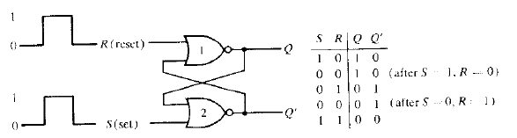
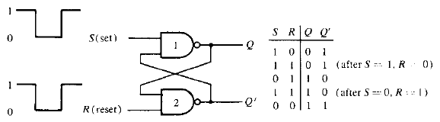
Basic Flip-Flop Circuit

Slide 7
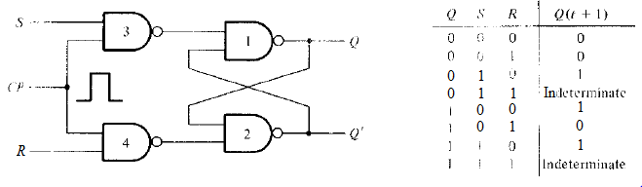
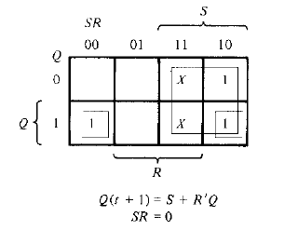
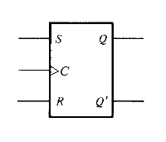
Clocked RS Flip-Flop

Slide 8
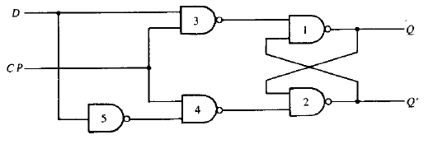
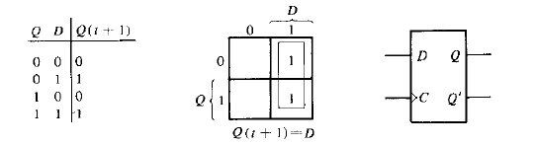
D Flip-Flop

Slide 9
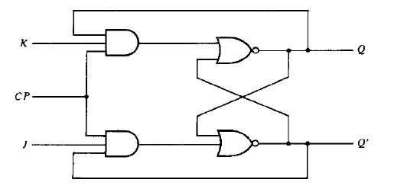
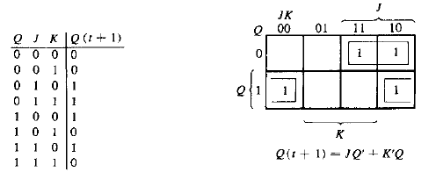
JK Flip-Flop

Slide 10
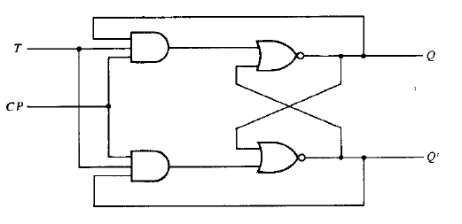
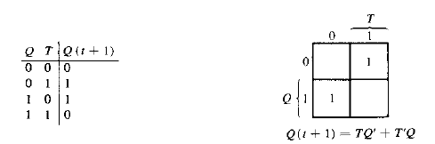
T Flip-Flop

Slide 11
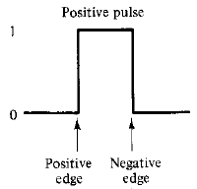
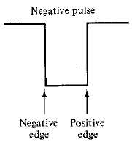
Triggering of Flip-Flops
Clocked flip-flops are triggered by pulse.
The outputs of memory elements change while the outputs of combinational circuit go to the flip-flops after a pulse transition.

Slide 12
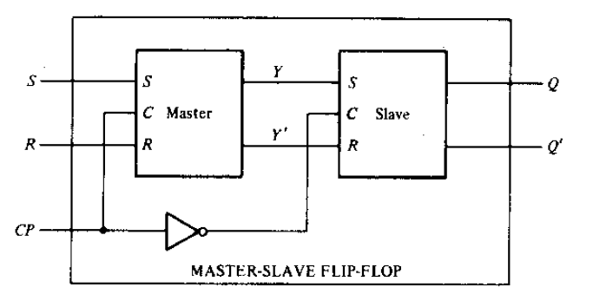
Master-Slave Flip-Flop

Slide 13
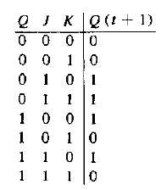
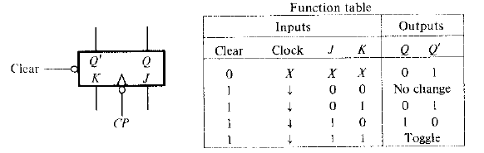
Direct Inputs
Flip-flops available in IC packages sometimes provide special inputs for setting or clearing the flip-flop asynchronously.
These inputs are called direct preset or direct clear.

Slide 14
Analysis of Clocked Sequential Circuits
A logic diagram is recognized as the circuit of a sequential circuit if it includes flip-flops.
The analysis of sequential circuits consists of obtaining a table or a diagram for the time sequence of inputs, outputs and internal states.
It is possible to write Boolean expressions that describe the behavior of sequential circuits.
These expressions must include the necessary time sequence either directly or indirectly.

Slide 15
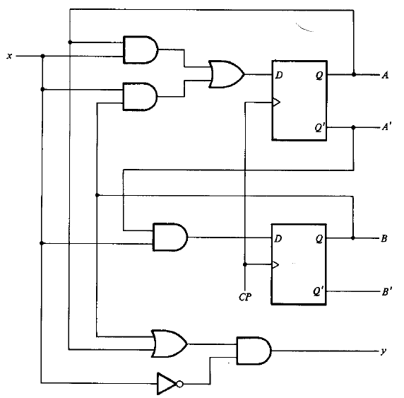


Example of a Sequential Circuit

Slide 16
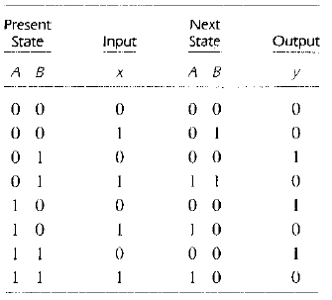
State Table

Slide 17
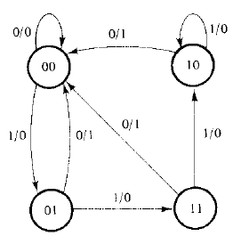
State Diagram
A state is represented by a circle and the transition between states is indicated by directed lines connecting circles.
The directed lines are labeled with two binary numbers separated by a slash ‘/’.
The first label indicates input while the second one indicates output.

Slide 18
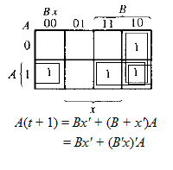
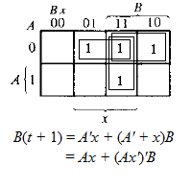
State Equations
A state equation is an algebraic expression that specifies the conditions for a flip-flop state transition.

Slide 19
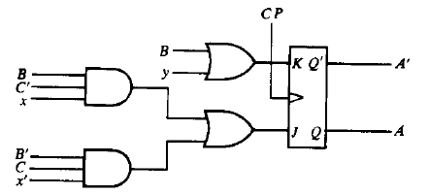


Flip-Flop Input Functions
The part of the combinational circuit that generates external outputs is described algebraically by the circuit output functions.
The part of the circuit that generates the inputs to flip-flops are described algebraically by a set of Boolean functions called flip-flop input functions.

Slide 20
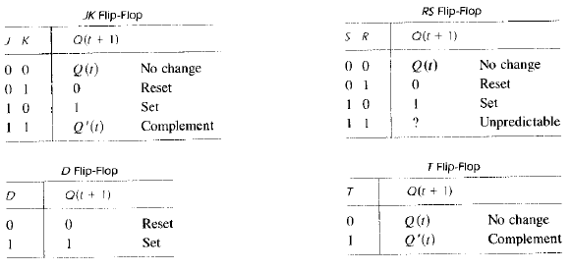
Characteristic Tables
The analysis of a sequential circuit with flip-flops needs the knowledge of characteristic tables.
The next state Q(t+1) is defined as the function of the present state Q(t) and inputs.

Slide 21
Analysis with JK and Other Flip-Flops
The next state values of a sequential circuit with D flip-flop can be derived directly from the next state equations.
For other, JK, RS, or T the next state can be derived by following a two-step procedure:
Obtain the binary values of each flip-flop input function in terms of the present state and input variables.
Use the corresponding flip-flop characteristic table to determine the next state.

Slide 22
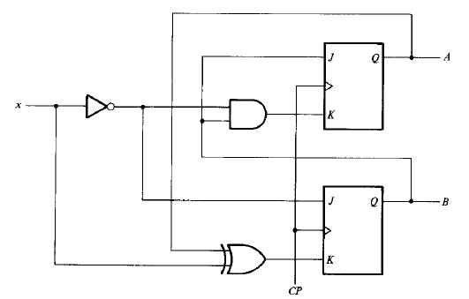
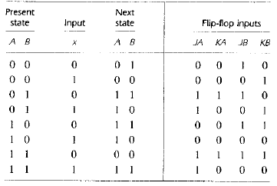

Analysis with JK and Other Flip-Flops

Slide 23
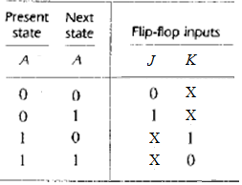
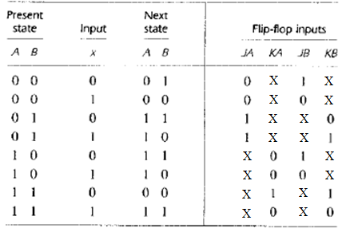
Another Solution

